Slide 1
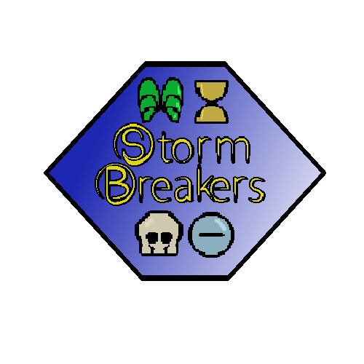
End-term Report

Slide 2
Team Storm
Brett Blackstock - Project Leader, Lead Programmer
Michael Krause - Project Manager, Lead Narrative
Charlie Brown - Narrative / Utility
Wade Hetland - Narrative / Utility
Rachel Groth - Programmer
David Enersen - Lead Artist
Quincton Rush - 2D Artist
Skyler Wittmer - 2D Artist
Garrett Verhoeven - Contract Sound Designer

Slide 3
Pitch
The four elements, Life, Death, Space, and Time, once kept in precarious balance are out of control. Amidst the chaos, two champions face off in this accessible 2D fighter. Choose your element and unleash its powers in Stormbreakers.
Notes:
Brett

Slide 4
What We Are Creating
Fighting Game!
Two characters (Randolf and Lynne) with four different enhancements, each with unique styles of play.
Enhancements include Death, Space, Life, and Time.
Players choose a character to determine moveset and an elemental enhancement to determine playstyle
Simple control scheme allows even beginners to compete.
Core Experience: A fighting game accessible to newcomers that introduces variety through elemental enhancements.
Notes:
Michael

Slide 5
Technical Details
Target Audience - People interested in the competitive nature of fighting games, but intimidated by their normal barrier to entry.
Target Hardware - Primary focus of Windows PC, with possible ports to Xbox One and PS4.
Notes:
Charles

Slide 6
Characters
Randolf
Fights primarily with his fists
Acts similar to “Shoto” characters (Ryu / Ken from StreetFighter)
Lynne
Focused more on kicks
Much more rushdown oriented
Sacrifices defensive abilities for offense
Notes:
Wade

Slide 7


Elements
Space
Supplements a defensive playstyle
Has lots of defensive options and reversals.
Adds armor to moves, reflects projectiles, etc.
Death
Acts as a zoning/keepaway element
Create acid rain and poison clouds to push opponents away
Notes:
Quincton

Slide 8


Elements (cont’d)
Life
Well-rounded style of play
Unique special moves add an extra layer of space control
All special attacks restore some life to the player when hitting the opponent
Time
Technical Rushdown sort of element
Can speed up player’s movement or slow down the opponent
Notes:
Skyler

Slide 9

Programming
Made using Unity
Coded in C#
Runs at 60FPS
Utilizes built-in Unity features
Physics
UI
Hiboxes
Animations
Full controller support
Notes:
Rachel

Slide 10
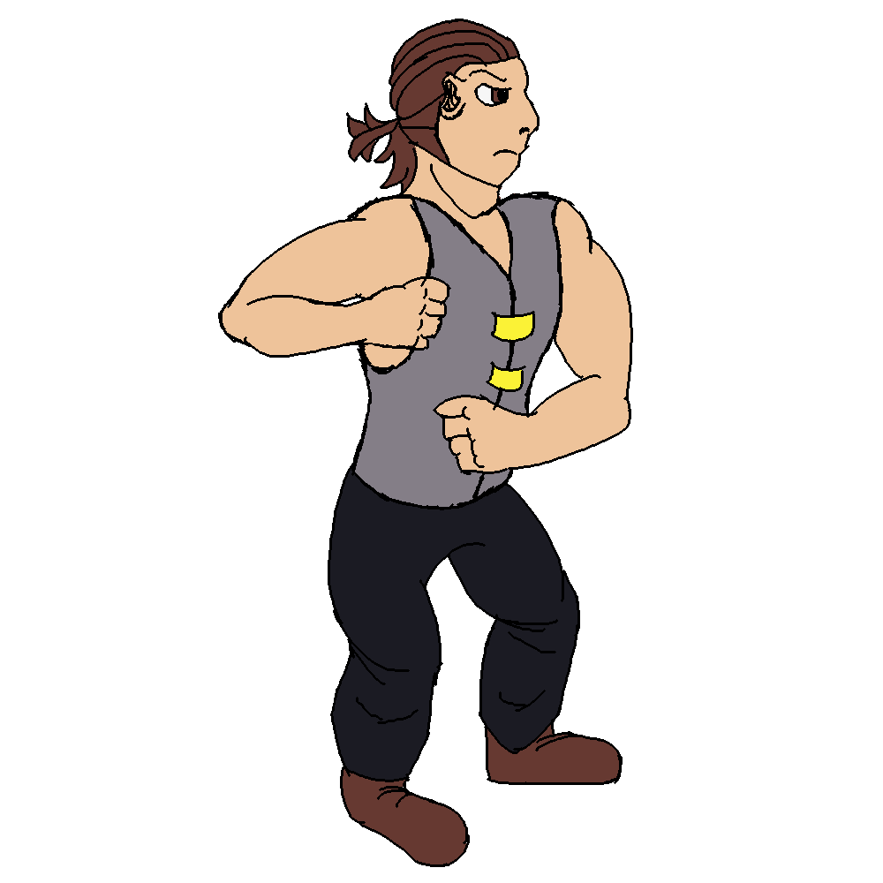
Art
2D Sprites
Hand-Drawn
Old-school style of animation
Possible exploration of Mandalas to represent elements
Vibrant, angular UI
Notes:
David

Slide 11
Audio
High-Impact Hitsounds
One background track per stage
Full sound effects
Fireball
Run
Hit/Block
Jump
Etc.
Menu SFX
Notes:
Wade

Slide 12
Narrative
Conflict between our two characters
Randolf and Lynne
Old vs New
Tradition vs expanding horizons
Building narrative
Worldbuilding
UI
Mix of styles
Notes:
Mikhael

Slide 13
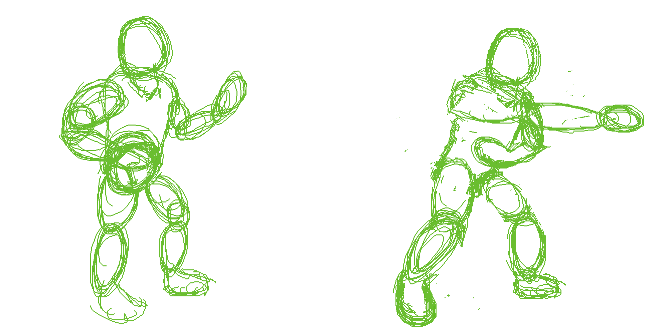
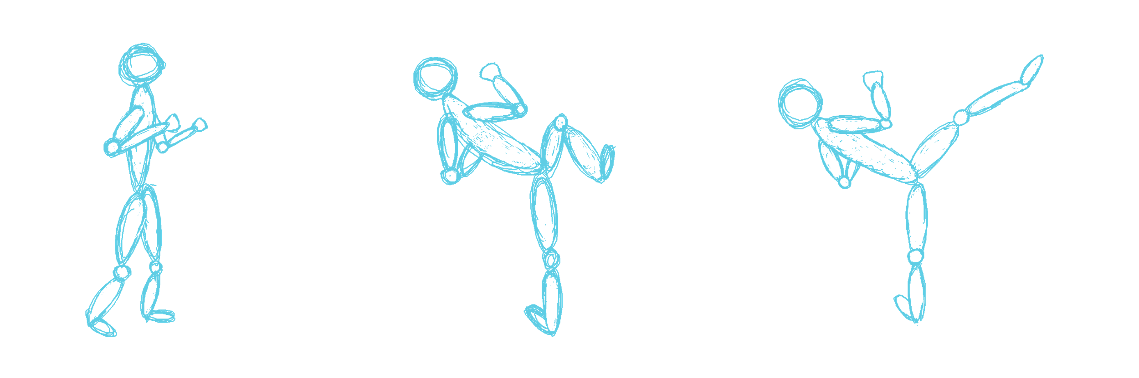
Progress
Beyond the Minimum Viable Product
Playable Game!
Both characters playable
First iteration of figure drawings done
1-2 Animation frames per attack
Functional UI and menus
Basic sound effects
Early background music
Notes:
Brett

Slide 14
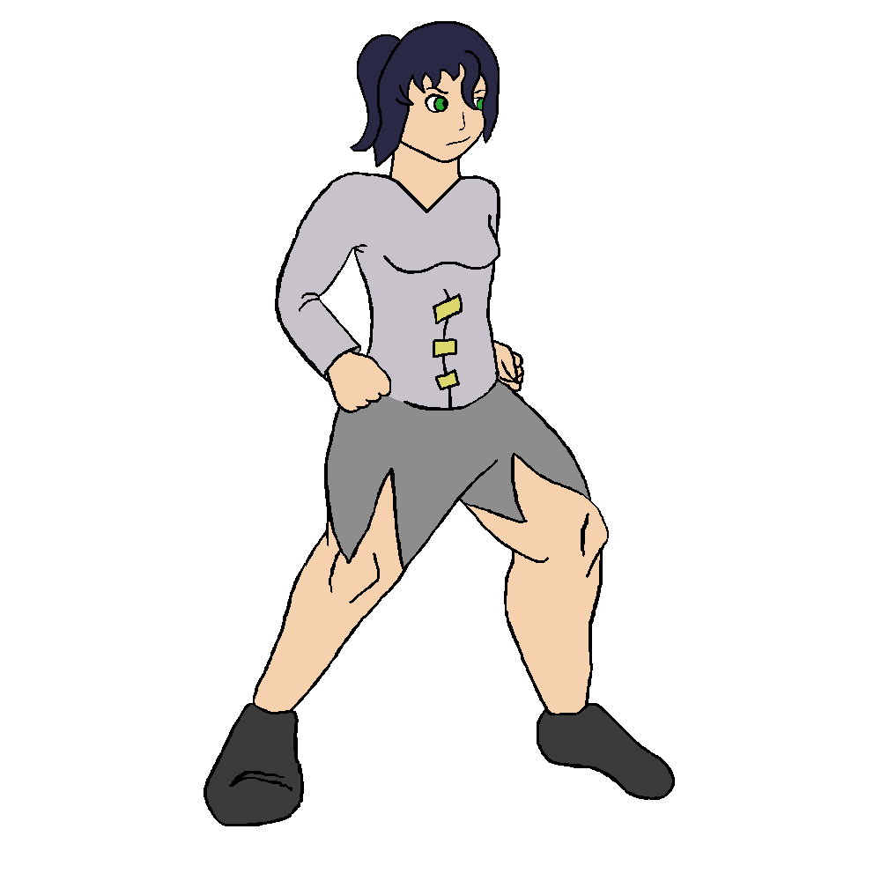
Progress (cont’d)
Character concept art fleshed out
Narrative Documentation Written
World Bible
Stage Descriptions
Style Guides
Attack Outline Documents
Most mechanics implemented
Life and Death playable
Notes:
Charles

Slide 15

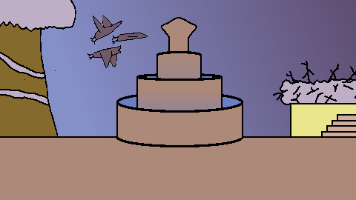
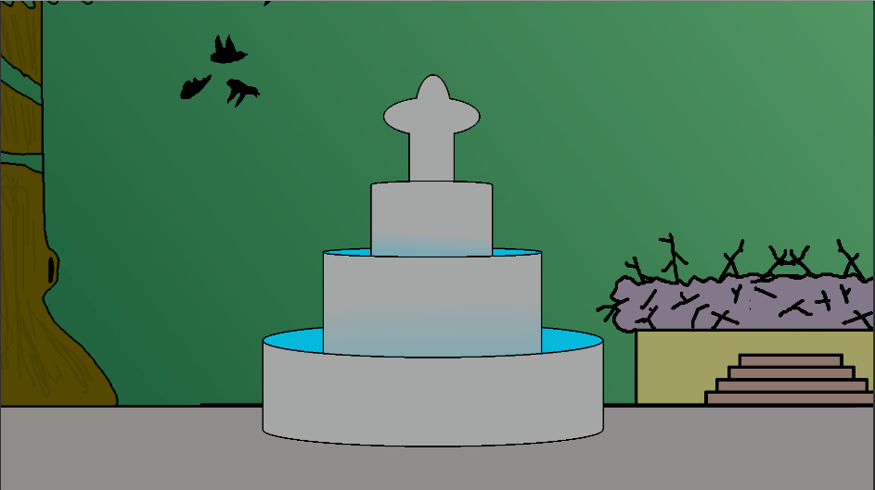
Accessibility
Simple motions
Input Display
Reference Sidebars
Input Leniency
Input Buffers
Notes:
Rachel

Slide 16
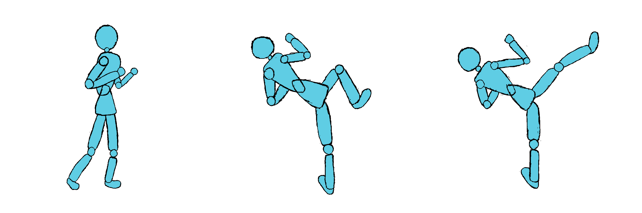
Moving Forward
Continue iterating on character artwork
Implement Space and Time
Add special attacks
Balancing
Continue to flesh out the world
Plan additional features
Training Mode
Story Mode
Arcade Mode
Notes:
David

Slide 17
Lessons Learned
Brett - Communication is important. Making sure all divisions of a project stay informed of each other’s progress will help achieve a coherent vision.
Michael - Stronger team management and sound design experience.
Charlie - Missing a class period is distasteful but missing a work-block is a much larger detriment to the team and its progress.
Wade - I learned a lot about audio work and the benefits of regular work blocks.
Notes:
Michael-

Slide 18
Lessons Learned (Cont’d)
Rachel - Most problems can be solved by intensive googling and asking random other teams. People are great resources!
David - There’s a lot of factors to consider when animating a fighting game, as it takes time, patience, and concentration to produce results.
Quincton - Drawing and animating sprites takes much more time than regular drawing and animation.
Skyler - It’s easy to draw things in Aesprite. Editing them, however, is the real challenge.
Notes:
Michael-

Slide 19
Gameplay Video

Slide 20

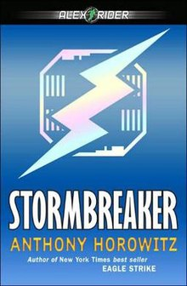
Inquiries? Statements? Uncertainties?

